Slide 1
CodSoft Data Science Internship
Machine Learning Projects Portfolio
MADHUMITHA JM

Slide 2
Internship Overview
Duration: June 2025 Organization: CodSoft Objective: Apply data science and machine learning techniques to solve real-world problems using datasets from Kaggle Completed Tasks: 3 (Titanic Survival, IMDb Rating Prediction, Iris Classification)

Slide 3
Tools & Technologies
• Google Colab • Python • Pandas, NumPy • Scikit-learn • Matplotlib, Seaborn • Kaggle API / manual data upload

Slide 4
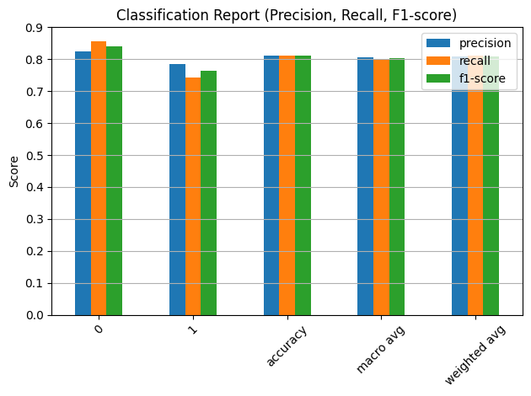
Task 1 - Titanic Survival Prediction
Dataset: Titanic Dataset (yasserh/titanic-dataset) Goal: Predict survival based on passenger details Model: Logistic Regression Accuracy: 81% Evaluation: Confusion Matrix, Classification Report [Graph Placeholder]

Slide 5
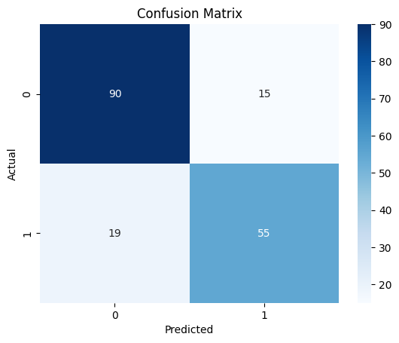
Task 1 - Outcomes
• Survival countplot by sex and class • Binary classification using logistic regression • Learned to handle missing values and categorical encoding

Slide 6
Task 1 - Code & Process
Downloaded dataset from Kaggle using kaggle.json
Loaded data with Pandas and handled missing values in Age and Embarked
Dropped unneeded columns like Cabin, Name, Ticket
Applied one-hot encoding to categorical columns (Sex, Embarked)
Split data into train and test sets (80-20)
Used Logistic Regression for classification
Evaluated model with accuracy score and confusion matrix
Visualized classification report and confusion matrix using matplotlib and seaborn

Slide 7
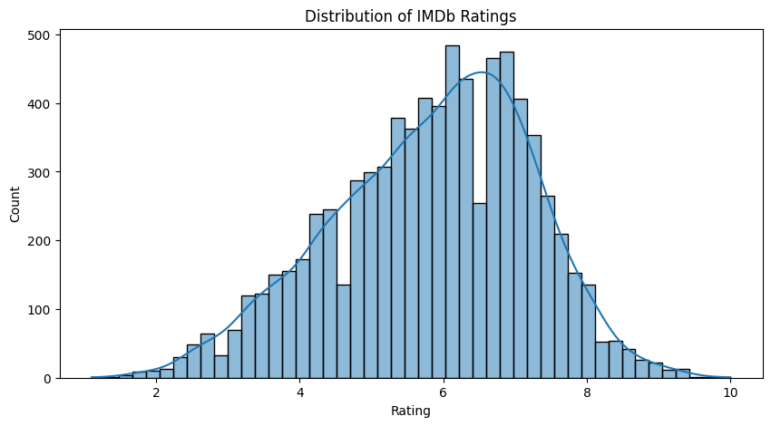
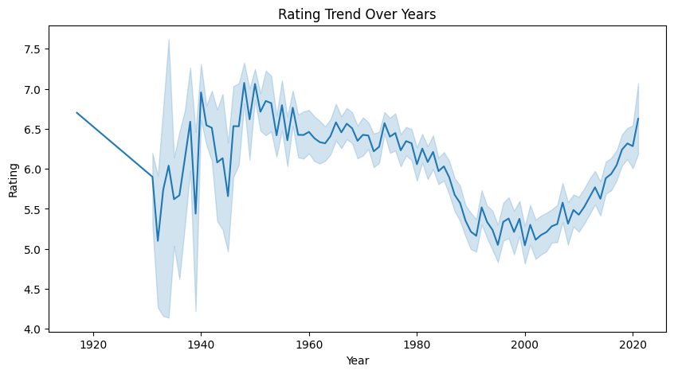
Task 2 - IMDb India Movie Rating Prediction
Dataset: adrianmcmahon/imdb-india-movies Goal: Predict IMDb rating using movie metadata Model: Random Forest Regressor Evaluation: Mean Squared Error (MSE) Features: Genre, Director, Actors, Duration, Votes [Graph Placeholder]

Slide 8
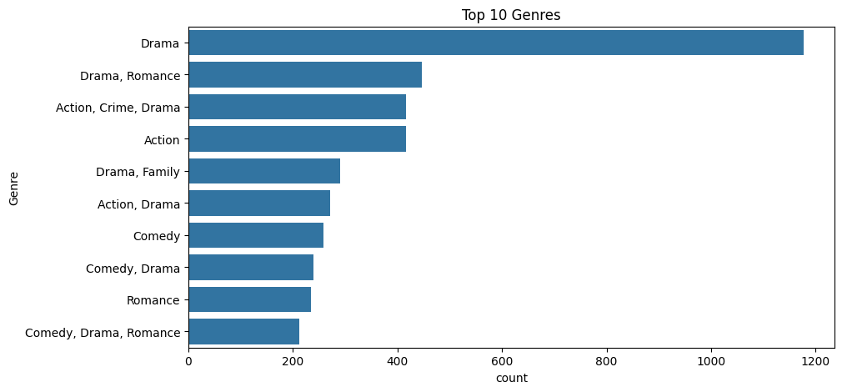
Task 2 - Outcomes
• Visualized top genres, rating trends • Performed regression with encoded categorical features • Exported prediction results to CSV

Slide 9
Task 2 - Code & Process
Uploaded and extracted IMDb dataset ZIP
Cleaned column names and handled missing/invalid values
Extracted numeric values from Duration and Year columns
Encoded categorical columns like Genre and Actors using LabelEncoder
Visualized rating distribution, top genres, and rating trends over years
Split data into train and test sets (80-20)
Used Random Forest Regressor to predict ratings
Calculated Mean Squared Error (MSE) and exported predictions to CSV

Slide 10
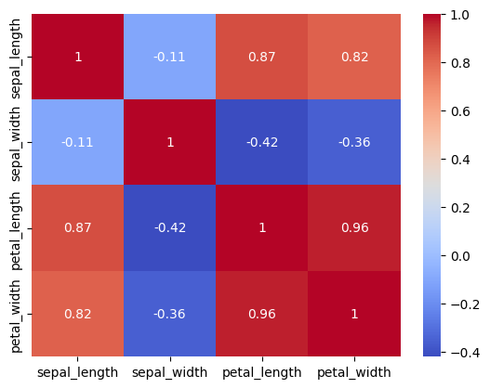
Task 3 - Iris Flower Classification
Dataset: IRIS.csv Goal: Classify iris species (Setosa, Versicolor, Virginica) Model: Random Forest Classifier Accuracy: 93% [Graph Placeholder]

Slide 11
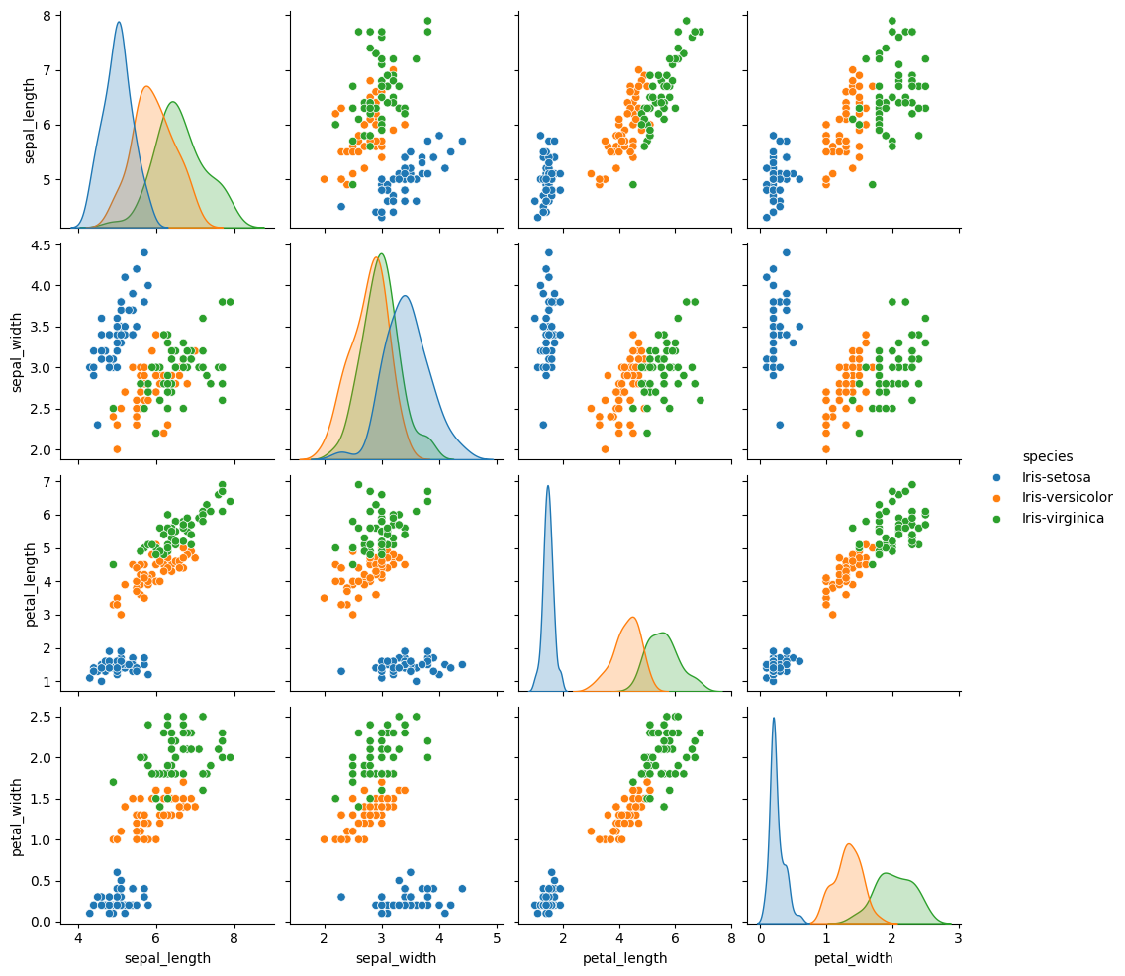
Task 3 - Outcomes
• Used pairplot and heatmap for feature analysis • Evaluated model with clean tabular classification report • Applied end-to-end ML workflow

Slide 12
Task 3 - Code & Process
Uploaded and extracted Iris dataset ZIP
Removed duplicate records and stripped column names
Visualized feature relationships using pairplot and heatmap
Encoded species labels and scaled features with StandardScaler
Split data into train and test sets (80-20)
Trained Random Forest Classifier with 100 estimators
Evaluated model using confusion matrix and classification report
Displayed evaluation metrics in a clean DataFrame format

Slide 13
Learning Outcomes
• Hands-on experience with real datasets • Applied EDA, preprocessing, regression & classification • Developed clean and readable ML code in Colab • Gained confidence in presenting ML projects

Slide 14
Project Notebook Links
• Task 1: https://colab.research.google.com/drive/1VYZ2HLpElL5TzeA7sVpnut8Gm2ZL2Vyk#scrollTo=lwgM2lAyTPwG • Task 2: https://colab.research.google.com/drive/1VAu81rzi1xAJETmWw93trfNzjir6qwZT#scrollTo=BxrLy2bdOdGW • Task 3: https://colab.research.google.com/drive/1pYqkFYIJ4i5otSuRuYCorV7S2p9DOfnq#scrollTo=wtHqo3Pycblh

Slide 15
Resources & References
• Kaggle Datasets • Scikit-learn Documentation • Google Colab for code execution • Matplotlib & Seaborn for EDA • GitHub for version control

Slide 16
Thank You
Thank you CodSoft for this internship opportunity. Excited to continue building in data science. - MADHUMITHA JM

